Slide 1

WWW, Internet &Protocols
6th yr Computer Science

Slide 2

The Internet
The Internet is a global network, which allows computers to talk to each other.
https://www.telstra.com.sg/content/dam/shared-component-assets/tecom/networks/global-networks/global-internet/hero-banner.jpg

Slide 3

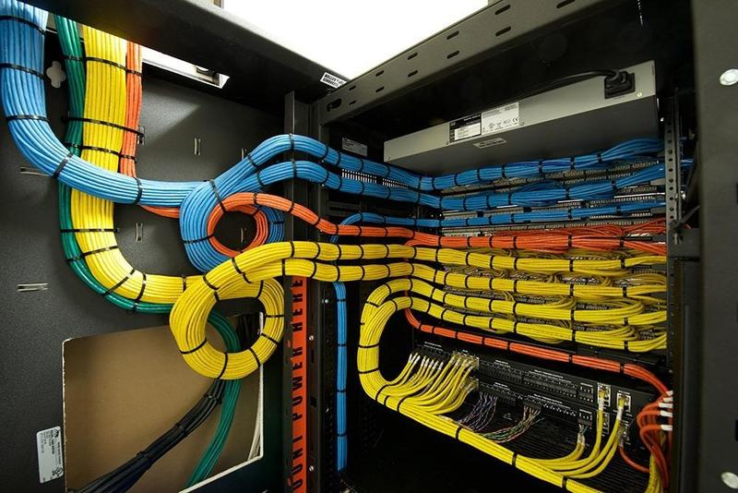
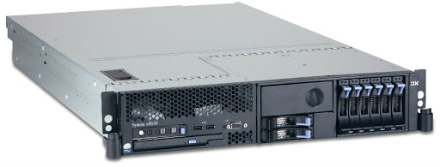
The Internet
It requires hardware and software to operate and allows vast amounts of data to be transmitted over land and under oceans, from one side of the world to the other.
Routers, switches and servers in millions of locations around the globe use over 300 underwater cables and countless cables above ground to connect to each other.

Slide 4
The World Wide Web
The World Wide Web (WWW) is an application that runs on the Internet.
There are many applications and protocols operating on the Internet that provide the services we use every second of every day.
HTTP | HTML
URL | CSS
DNS | Javascript
FTP | Email

Slide 5
The World Wide Web
The World Wide Web (WWW) uses the Internet as a transmission medium. Without the Internet, the Web wouldn’t work.
The web was invented by Tim Berners-Lee in 1989. He created a way of putting websites onto the Internet. All these websites together are what is known as the World Wide Web.
Think of the Web as a vast collection of documents (often HTML that represent web sites) with links to each other.
The web is only one use of the Internet. Other uses are email, instant messaging, streaming services etc

Slide 6
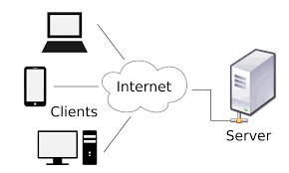
Client Server Relationships
When you visit a web page, your computer (the client) issues a request that eventually makes its way to the appropriate server.
The server is a computer that provides resources or services to other computers.
The server then carries out that request and the information representing the webpage/resources is transmitted back to your computer(the client)
Your browser then renders the information received into the website you see.

Slide 7
Client Server Relationships
Client - Server Model
The WWW application uses the client-server model to communicate.
There are two sides in this model:
Server (a device where data is stored)
Web Server
Email Server
Client (the applications on our phones, tablets & computers)
Internet Browser
Email Application

Slide 8
Client Server Relationships
Client - Server Model
In general, CLIENTS request the resources or services and servers provide them.
The client-server model is a simple distributed (shared) system. A distributed system is where the workloads required to complete a task are shared between more than one computer. These computers are connected by a network, over which messages re sent in order to complete the required task.

Slide 9
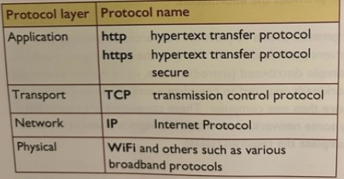
Communication Protocols
A communication protocol is a set of rules describing how to transmit data across a network. This network , can be the internet.
The client server model uses several different protocols, each governing communication in its own protocol LAYER of the network. Without these protocol (set of rules) the client server model would not work.

Slide 10
TCP / IP Suite of Protocols
Transmission Control Protocol / Internet Protocol (TCP/IP) refers to a suite of protocols used to send and receive messages over the internet. The TCP/IP protocol suite contains a number of different layers.
1. **Application Layer**: encodes / decodes the message into a form that is understood by the sender and the recipient devices using protocols such as HTTP, FTP and SMTP.
2. **Transport Layer**: **: breaks down the message into small pieces called packets. Each packet is given a packet number and the total number of packets. The recipient uses this information to re-assemble the packets in the correct order. It also allows the recipient to see if there are any missing packets. .This uses protocols like TCP (Transmission Control Protocol)

Slide 11
TCP / IP Suite of Protocols
Transmission Control Protocol / Internet Protocol (TCP/IP) refers to a suite of protocols used to send and receive messages over the internet. The TCP/IP protocol suite contains a number of different layers.
3. **Internet Layer**: Also known as the Network Layer,adds the sender’s IP address and that of the recipient. The network then knows where to send the message, and where it came from. The primary protocol at this layer is IP (Internet Protocol
4. **Link Layer**: enables the physical transfer of packets between nodes on a network, and between one network and another. It includes protocols that govern communication within a single network segment, such as Ethernet or Wi-Fi

Slide 12
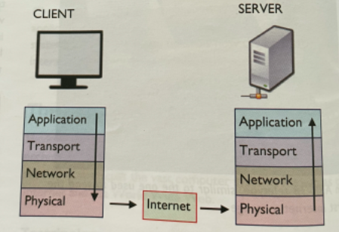
Communication Protocols
Client - Server Model
This is the path taken by a client request, via the internet, to a particular server.
The request travels “down” through the the protocol layers in the client,
then through the internet,
The passes “up” through the protocol layers in the server.
Request is then handled by the server and the information is sent back to the client via the same path

Slide 13
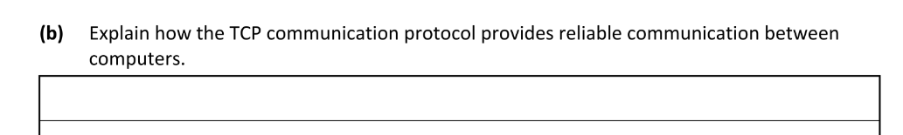
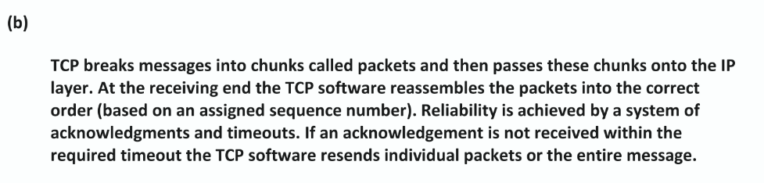
Exam Questions

Slide 14
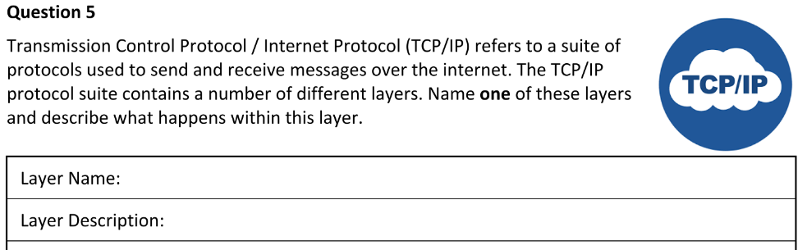
Exam Questions

Slide 15
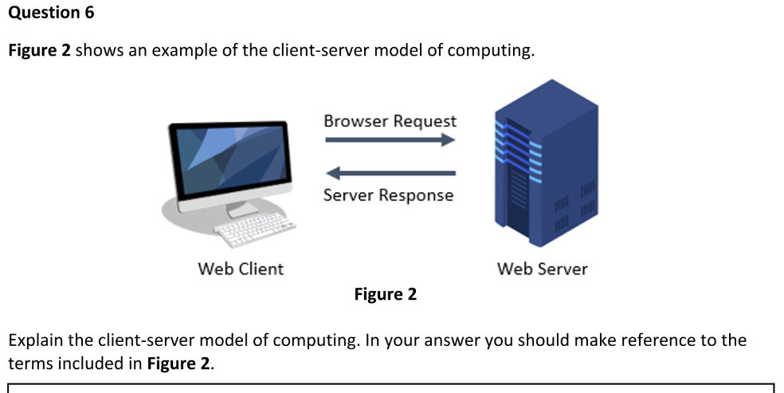
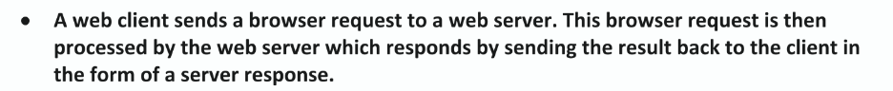
Exam Questions

Slide 16
HTTP (Communication Protocols)
HTTP – Hyper Text Transfer Protocol -> Application Layer
- Shown at the beginning of web addresses
Operates in the application (program) layer of the network
Known as the request-response protocol as it allows a client to issue a request for a resource (e.g. website) and the server to respond to the right computer with the resource required.

Slide 17
HTTPS (Communication Protocols)
HTTPS - Hyper Text Transfer Protocol Secure
- is the secure version of HTTP which automatically encrypts all traffic to and from the server.
- theoretically, anyone intercepting communications between the client and the server can’t read the messages. (They are encrypted)
- This has allowed for secure banking and online shopping to become as popular as they are.

Slide 18
TCP (Communication Protocols)
TCP – transmission control protocol -> Transport Layer
TCP operates at the transport layer,
The message is broken into “packets” for efficient routing
breaks down the message into small pieces called packets. Each packet is given a packet number and the total number of packets. The recipient uses this information to re-assemble the packets in the correct order. It also allows the recipient to see if there are any missing packets.

Slide 19
IP - Internet protocol (Communication Protocols) -> Network Layer
IP operates at the network layer.
IP is responsible for the routing of packets from the source device to the destination device via a network of inter-connected computer called the internet
Does this using IP addresses e.g 192.168.4.210
IP address is a unique code that identifies a computer network or particular computer on a network.

Slide 20
WiFi (Communication Protocols) -> Physical Layer
The WiFi protocol operates at the physical layer. It manages the flow of data around a WiFi network such as the one in your home.
WiFi is the radio wave technology that allows devices (phones, TVs, laptops, printers) to communicate with each other and access the internet wirelessly.

Slide 21
Recap of TCP/IP Protocol Layers Recap
Video -> What is TCP/IP?

Slide 22
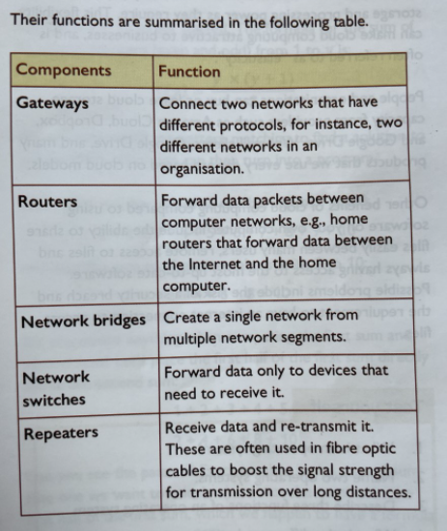
Internet Hardware Components
The internet is made up of many different hardware components that connect the end-user devices such as computers or laptops.
These internet hardware components move data from place to place and include gateways, routers, bridges, switches and repeaters
-These components typically connect to each other over a combination of radio signals, copper cables and fibre optic cables
Introduction to Network Devices

Slide 23
Cloud Computing
Cloud computing is a technology that uses the internet for storing and managing data on remote servers and then access data via the internet. This type of system allows users to work on the remote. Cloud computing customers do not own the physical infrastructure; they rent the usage from a third-party provider.
These third party providers are responsible for keeping the data available, accessible and secure. Customers need only pay for as much storage and processing power as they require

Slide 24
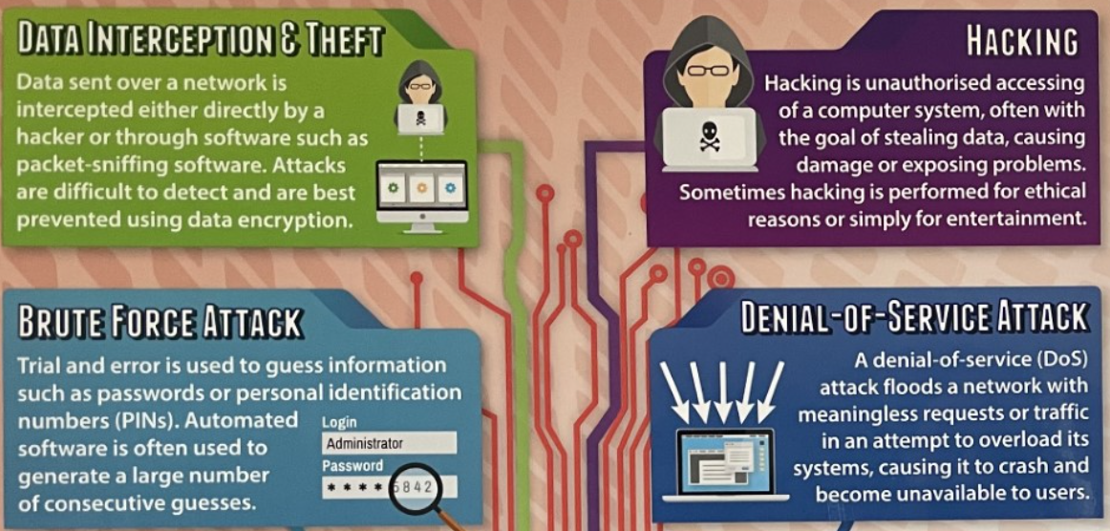
What are the security threats faced by computer users ?

Slide 25
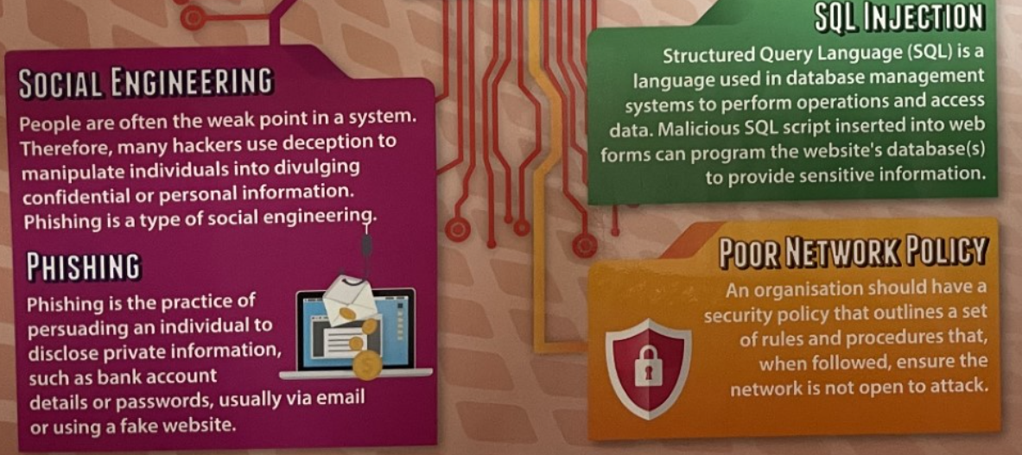
What are the security threats faced by computer users ?

Slide 26
What is Malware ?
Malware, or malicious software, is any program or file that is intentionally harmful to a computer, network or server.
The aim of malware is :
damage or delete files
Steal information
Take control of the system
What are the different types of malware?
Different types of malware have unique traits and characteristics. Types of malware include the following:
A virus is the most common type of malware that can execute itself and spread by infecting other programs or files.
A worm can self-replicate without a host program and typically spreads without any interaction from the malware authors.
A Trojan horse is designed to appear as a legitimate software program to gain access to a system. Once activated following installation, Trojans can execute their malicious functions.

Slide 27
Different Types of Malware ?
Spyware collects information and data on the device and user, as well as observes the user's activity without their knowledge.
Ransomware infects a user's system and encrypts its data. Cybercriminals then demand a ransom payment from the victim in exchange for decrypting the system's data.
A rootkit obtains administrator-level access to the victim's system. Once installed, the program gives threat actors root or privileged access to the system.
A backdoor virus or remote access Trojan (RAT) secretly creates a backdoor into an infected computer system that enables threat actors to remotely access it without alerting the user or the system's security programs.
Adware tracks a user's browser and download history with the intent to display pop-up or banner advertisements that lure the user into making a purchase. For example, an advertiser might use cookies to track the webpages a user visits to better target advertising.
Keyloggers, also called system monitors, track nearly everything a user does on their computer. This includes emails, opened webpages, programs and keystrokes

Slide 28
How is malware spread ?
Malware is spread in simple ways that trick people or take advantage of weak spots in computers. Here are the main ways:
Email Attachments or Links: You get an email that looks real, but it has a file or link that, when clicked, installs malware.
Infected Websites: You visit a website that secretly downloads malware onto your device, especially if your browser or software isn’t up to date.
Fake Apps or Software: You download an app or program that looks legit but actually contains malware.
USB Drives: Plugging in an infected USB stick can spread malware to your computer.
Social Media or Messages: Links sent through social media or messaging apps can lead to malware-infected sites.
Software Vulnerabilities: Hackers can exploit flaws in programs or operating systems to install malware without you doing anything.

Slide 29
Malware, how to protect yourself ?
Here are some simple and effective tips to protect yourself from malware:
Don't click on suspicious links or attachments – Even if it looks like it’s from someone you know, be cautious.
Use antivirus software – It helps detect and block malware before it can harm your system.
Keep software updated – Updates often fix security holes that malware can exploit.
Download apps and programs only from trusted sources – Stick to official websites and app stores.
Use strong, unique passwords – This helps prevent hackers from breaking into your accounts.
Back up your data regularly – If malware strikes, you won’t lose your important files.
Be cautious with public Wi-Fi – Use a VPN if you need to access sensitive information on public networks.

Slide 30
What is artificial intelligence (AI) ?
Artificial Intelligence is the capability of a computer system to mimic human cognitive functions such as learning and problem-solving.
Examples of Artificial intelligence
•Autonomous vehicles: AI is used to enable self-driving cars, which use sensors and machine learning algorithms to navigate roads and make driving decisions.
•Healthcare: AI is used in healthcare to analyze medical images, assist in diagnosis, and develop personalized treatment plans.

Slide 31
Different Types of AI
•Narrow AI: This type of AI is designed to perform a specific task, and it operates within a limited scope. Narrow AI is commonly used in applications such as virtual assistants, image recognition software, and language translation programs.
•General or Strong AI: This type of AI is capable of performing any intellectual task that a human can. However, currently, there is no true strong AI that has been developed, and it remains a theoretical concept.

Slide 32
Simple AI Vs Machine Learning
With simple AI, a programmer can tell a machine how to respond to various sets of instructions by hand-coding each “decision.”
With machine learning models, computer scientists can “train” a machine by feeding it large amounts of data. The machine follows a set of rules—called an algorithm—to analyze and draw inferences from the data. The more data the machine parses, the better it can become at performing a task or making a decision.

Slide 33
What is Machine Learning
Machine learning is a way for computers to learn from data and make decisions or predictions without being told exactly what to do.
Think of it like this:
Instead of programming a computer with step-by-step instructions, we give it lots of examples (data).
The computer looks for patterns in that data.
Then, it uses those patterns to guess or decide things in the future.
For example:
Show it thousands of photos of cats and dogs, and it learns to tell them apart.
Give it information about houses and prices, and it can predict how much a new house might cost.
It’s like teaching a child by showing examples instead of just giving rules.

Slide 34
Types of machine learning
1. Supervised Learning
The computer is taught with labeled data (the answers are already given).
Example: Show pictures of animals with labels like "cat" or "dog", and the computer learns to tell the difference.
It’s like learning with a teacher who gives you the right answers to study.
2. Unsupervised Learning
The computer is given data without any labels and has to find patterns or groups on its own.
Example: Give it photos of animals, but don’t say what they are—it might group cats together and dogs together by noticing similarities.
It’s like solving a puzzle without any instructions.

Slide 35
Types of Machine Learning
3. Reinforcement Learning
The computer learns by trial and error, getting rewards or penalties.
Example: Like training a dog—if it does the right thing, it gets a treat.
Used in things like game-playing robots or self-driving cars.

Slide 36
Positives of AI
1. Saves Time
AI can do tasks faster than humans, like sorting emails or answering simple questions.
2. Works 24/7
AI doesn’t get tired—it can work all day and night without breaks.
3. Helps in Healthcare
AI helps doctors by finding diseases earlier, reading X-rays, or suggesting treatments.

Slide 37
Positives of AI
4. Smart Assistants
Tools like Siri, Alexa, or Google Assistant make life easier by helping with reminders, directions, and more.
5. Personalized Recommendations
AI suggests movies, music, or shopping items you might like, based on your past choices.
6. Better Safety
AI is used in self-driving cars and security systems to help reduce accidents and protect people.
7. Solves Big Problems
AI helps with things like predicting weather, fighting climate change, and advancing science.

Slide 38
Problems with AI
1. Bias
AI can be unfair if it learns from biased data.
Example: If it’s only trained on pictures of light-skinned people, it may not work well for darker-skinned people.
2. Lack of Understanding
AI doesn’t really understand like humans do—it just finds patterns.
It can make strange or wrong decisions if the situation is new or confusing.
3. Job Loss
AI can replace human workers in some jobs, especially repetitive or routine ones.

Slide 39
Problems with AI
4. Privacy Concerns
AI often needs lots of data, which can mean people’s personal information is collected and used without them knowing.
5. Hard to Control
Some AI systems are so complex that even the people who made them can’t fully explain how they work or why they make certain choices.
6. Misuse
AI can be used for bad purposes, like fake videos (deepfakes), hacking, or spreading lies.

